Slide 1
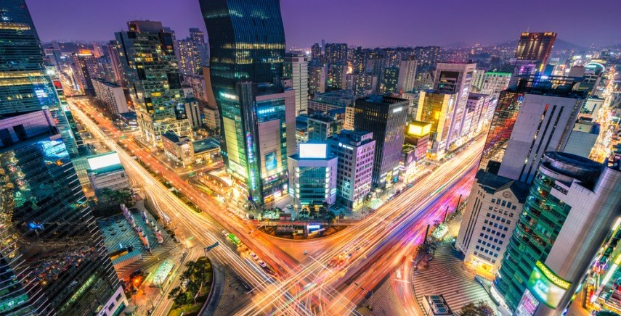
Functional Hierarchy of Settlement
Kaustuv Mukherjee
Assistant Professor
Department of Geography
Chandidas Mahavidyalaya, Birbhum

Slide 2
What is a Settlement?
In geography, statistics and archaeology, a settlement, locality or populated place is a community in which people live. A settlement can range in size from a small number of dwellings grouped together to the largest of cities with surrounding urbanized areas. Settlements may include hamlets, villages, towns and cities.
A settlement conventionally includes its constructed facilities such as roads, enclosures, field systems, boundary banks and ditches, ponds, parks and woods, wind and water mills, manor houses, moats and churches.
Simply, settlements are "a city, town, village or other agglomeration of buildings where people live and work.

Slide 3
What are the Major Types of Settlement?
Settlement
Rural
Hut
Village
Urban
Town
Hamlet
Rurban
City
Metropolis
Megalopolis
Primate

Slide 4
What is a Rural Settlement?
Population is less than 5000
Population density is less than 400 persons/Sq. km.
More than 75 % of people are engaged in Agricultural and associated primary activities
Run by Gram-Panchayets
What is an Urban Settlement?
Population is greater than 5000
Population density is greater than 400 persons/Sq. km. or 1000 persons/Sq. Mile
More than 75 % of people are engaged in Non-Agricultural activities
Run by Municipality, Cantonment Board, Corporation etc.

Slide 5
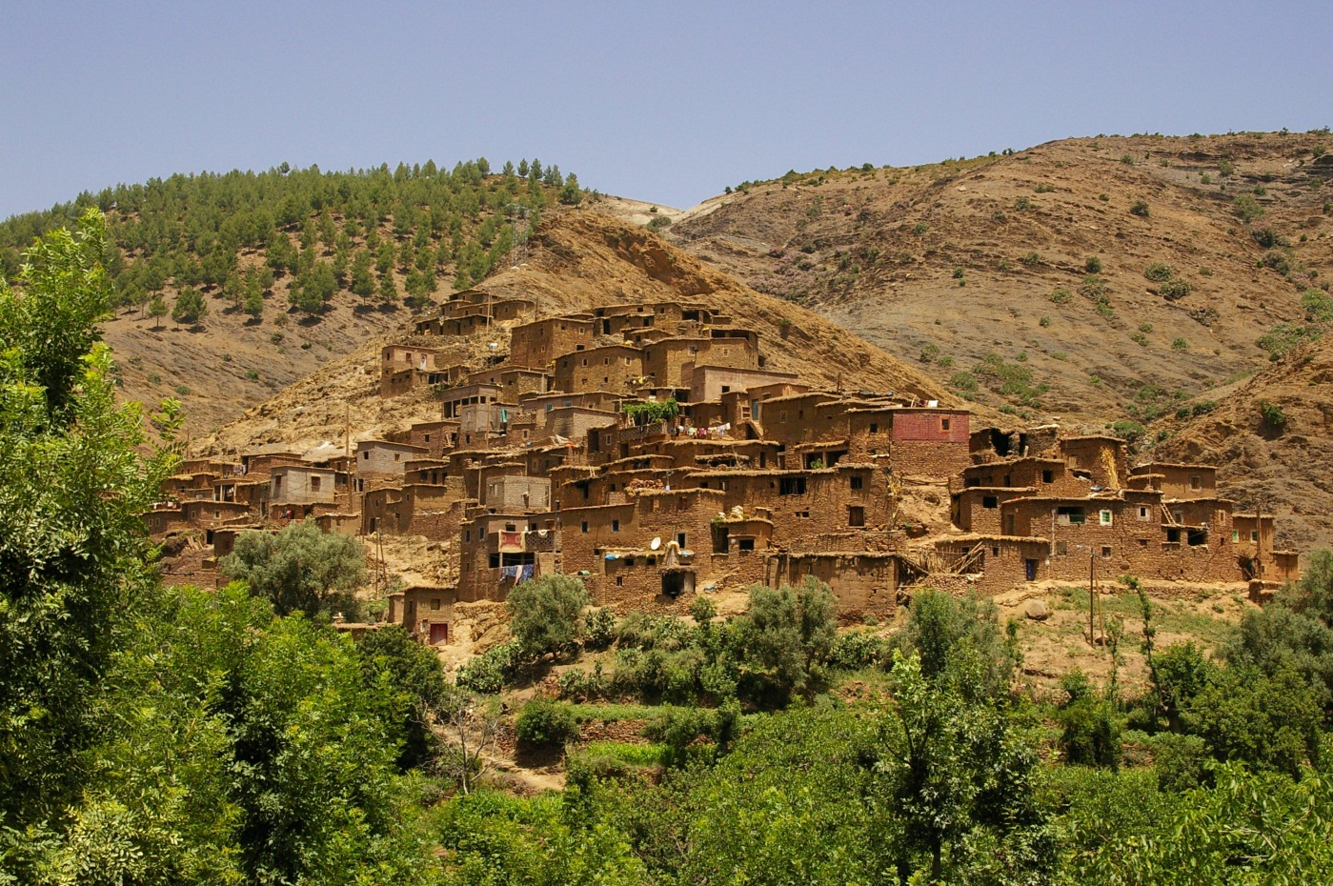
Hamlet
A hamlet is a small human settlement
In British geography, a hamlet is considered smaller than a village and distinctly without a church.
Officially, a hamlet differs from a village in having no commercial premises, but has residences and may have community buildings such as churches and public halls.

Slide 6
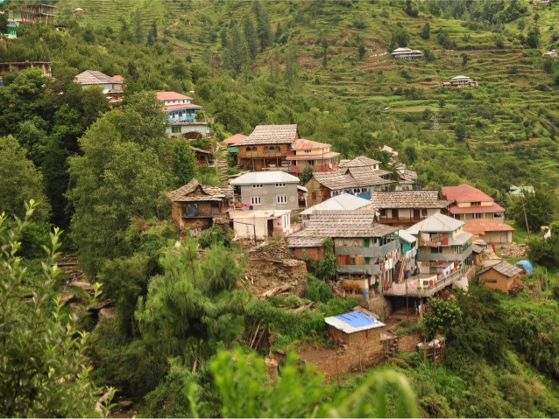
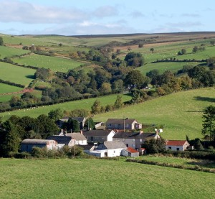
Village
A village is a clustered human settlement or community, larger than a hamlet but
smaller than a town, with a population ranging from a few hundred to a few
thousand.
In the past, villages were a usual form of community for societies that practice
subsistence agriculture, and also for some non-agricultural societies.
According to the 2011 census of India, 68.84% of Indians (around 833.1 million people) live in 640,867 different villages.

Slide 7
Rurban
Rural + Urban
Transitional Phase in between Rural and Urban settlements
Run by Gram Panchayets
Population is more than 5000 but less than 10,000

Slide 8
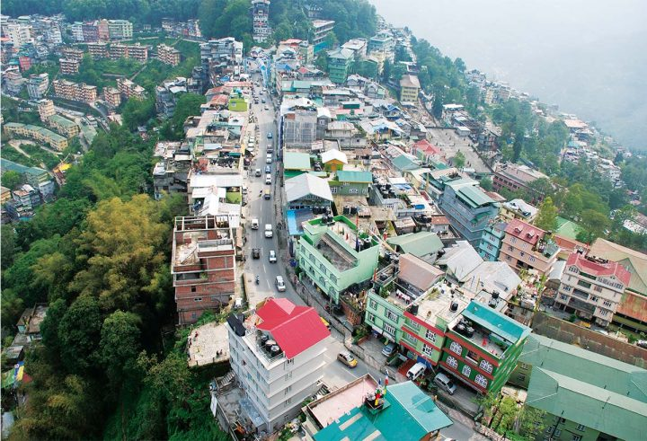
Town
A town is a medium-sized human settlement. Towns are generally larger than villages but smaller than cities, though the criteria which constitute them vary considerably in different part of the world.
Large town – 20,000 to 1 lakh people
Town – 5,000 to 20,000 people.
Census towns are defined as places that satisfy the following criteria:
1. Minimum population of 5,000
2. At least 75% of male working population engaged in non-agricultural pursuits
3. Density of population at least 400/km2. (1,000 per sq. mile).

Slide 9
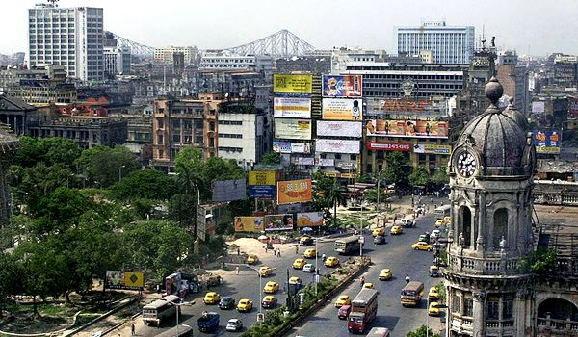
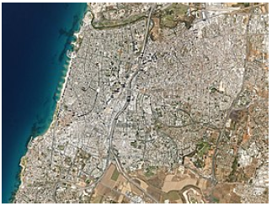
City
A city is a large human settlement. Cities generally have extensive systems for housing, transportation, sanitation, utilities, land use, and communication. Their density facilitates interaction between people, government organizations and businesses, sometimes benefiting different parties in the process.
City – 1 lakh to 3 lakh Population
Large City – 3 lakh to 1 million population

Slide 10
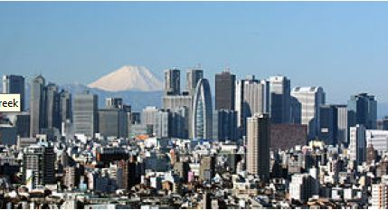
Metropolis
A metropolis is a large city or conurbation which is a significant economic, political, and cultural centre for a country or region, and an important hub for regional or international connections, commerce, and communications. The term is Ancient Greek and means the "mother city" of a colony (in the ancient sense), that is, the city which sent out settlers.
Minimum Population – 1 to 3 million.
Conurbation – 3 to 10 million people

Slide 11
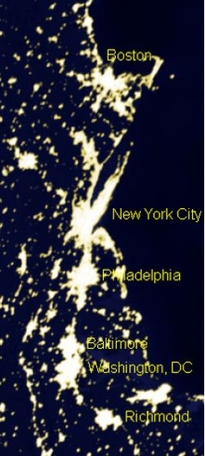
Megalopolis
The term was used by Patrick Geddes in his 1915 book Cities in Evolution. Jean Gottmann popularised this term in 1961.
A megalopolis (sometimes called a megapolis; also megaregion, or supercity) is typically defined as a chain of roughly adjacent metropolitan areas, which may be somewhat separated or may merge into a continuous urban region.
Megalopolis is derived from Greek:(mégas) meaning 'great' and (pólis) meaning 'city', therefore literally a 'great city'. This term is closer in meaning to megacity.
A megalopolis, also known as a mega-region, is a clustered network of cities.
Gottmann defined its population as 25 million.
Doxiadis defined a small megalopolis a similar cluster with a population of about 10 million.

Slide 12
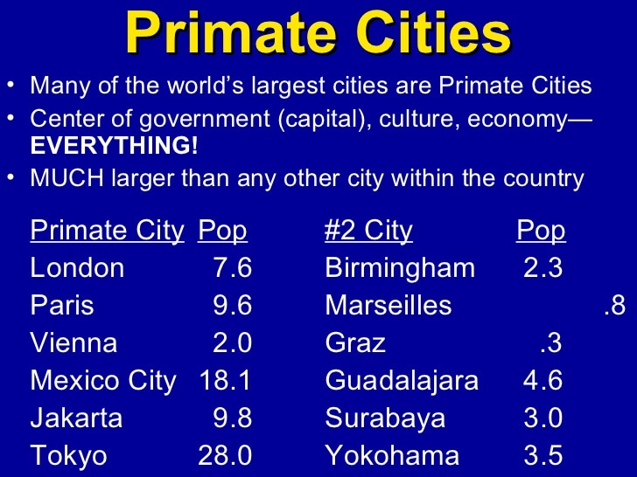
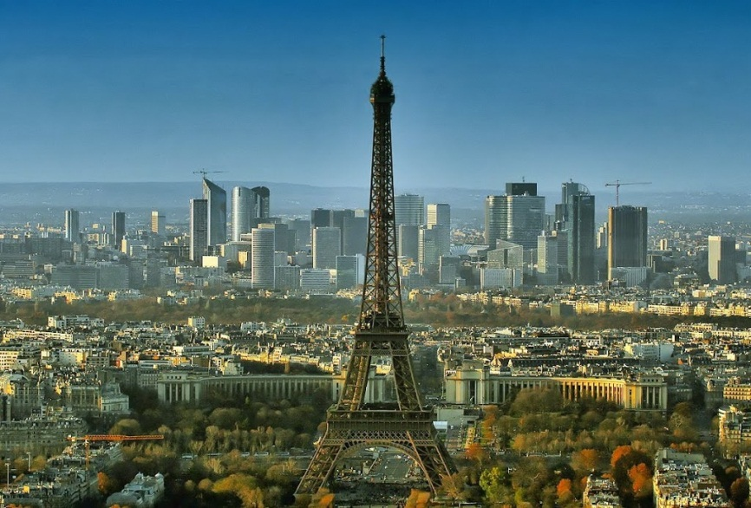
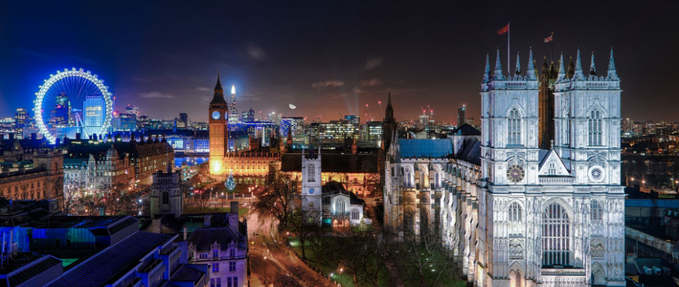
Primate City
A primate city (Latin: "prime, first rank") is the largest city in its country or region, disproportionately larger than any others in the urban hierarchy.
First proposed by the geographer Mark Jefferson in 1939.
He defines a primate city as being "at least twice as large as the next largest city and more than twice as significant."
Among the best known examples of primate cities are London and Paris.
Other major primate cities include Athens, Baghdad, Bangkok, Budapest, Buenos Aires, Cairo, Dublin, Jakarta, Kuala Lumpur, Lima, Mexico City, Seoul, Tehran, and Vienna.

Slide 13
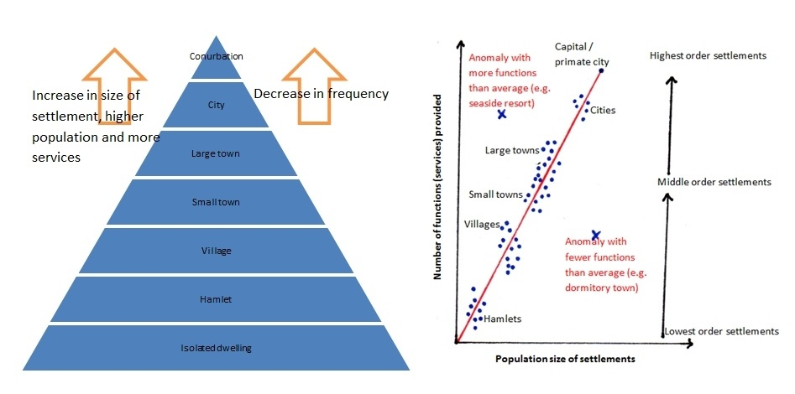
Hierarchy of Settlement

Slide 14
Functional Classification of Towns
Administrative towns and cities: Towns supporting administrative headquarters of higher order are administrative towns, such as Chandigarh, New Delhi, Bhopal, Shillong, Guwahati, Imphal, Srinagar, Gandhinagar, Jaipur Chennai, etc.
• Industrial towns: Industries constitute prime motive force of these cities such as Mumbai, Salem, Coimbatore, Modinagar, Jamshedpur, Hugli, Bhilai, etc.
• Transport Cities: They may be ports primarily engaged in export and import activities such as Kandla, Kochchi, Kozhikode, Vishakhapatnam, etc. or hubs of inland transport such as Agra, Dhulia, Mughal Sarai, Itarsi, Katni, etc.
• Commercial towns: Towns and cities specialising in trade and commerce are kept in this class. Kolkata, Saharanpur, Satna, etc. are some examples.
• Mining towns: These towns have developed in mineral rich areas such as Raniganj, Jharia, Digboi, Ankaleshwar, Singrauli, etc.
• Garrison Cantonment towns: These towns emerged as garrison towns such as Ambala, Jalandhar, Mhow, Babina, Udhampur, etc.
• Educational towns: Starting as centres of education, some of the towns have grown into major campus towns such as Roorki, Varanasi, Aligarh, Pilani, Allahabad etc.

Slide 15
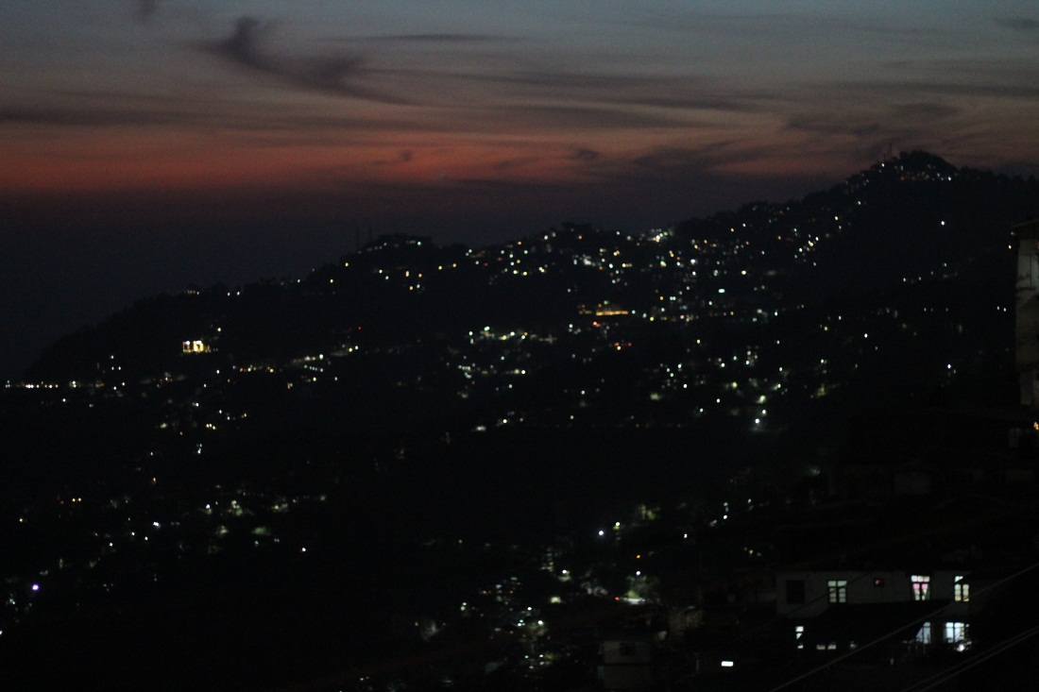
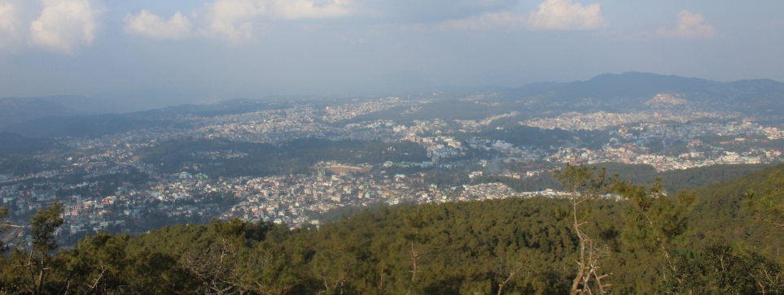
Defensive Towns: They are centres of military ac­tivities like city of Meerut and its cantonment.
• Religious and cultural towns: Varanasi, Mathura, Amritsar, Madurai, Puri, Ajmer, Pushkar, Tirupati, Kurukshetra, Haridwar, Ujjain came to prominence due to their religious/cultural significance.
• Tourist towns: Nainital, Mussoorie, Shimla, Pachmarhi, Jodhpur, Jaisalmer, Udagamandalam (Ooty), Mount Abu are some of the tourist destinations.

Slide 16
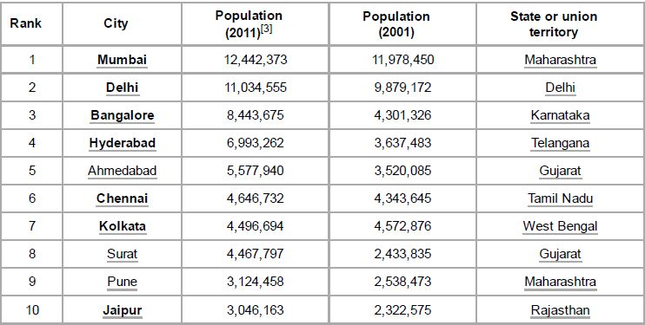
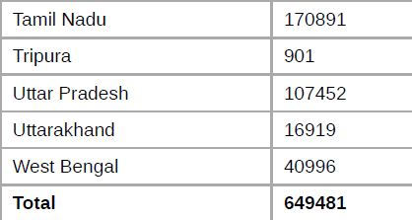
List of Cities
In Birbhum District
Total Villages - 2469
List of Villages
In World

Slide 17
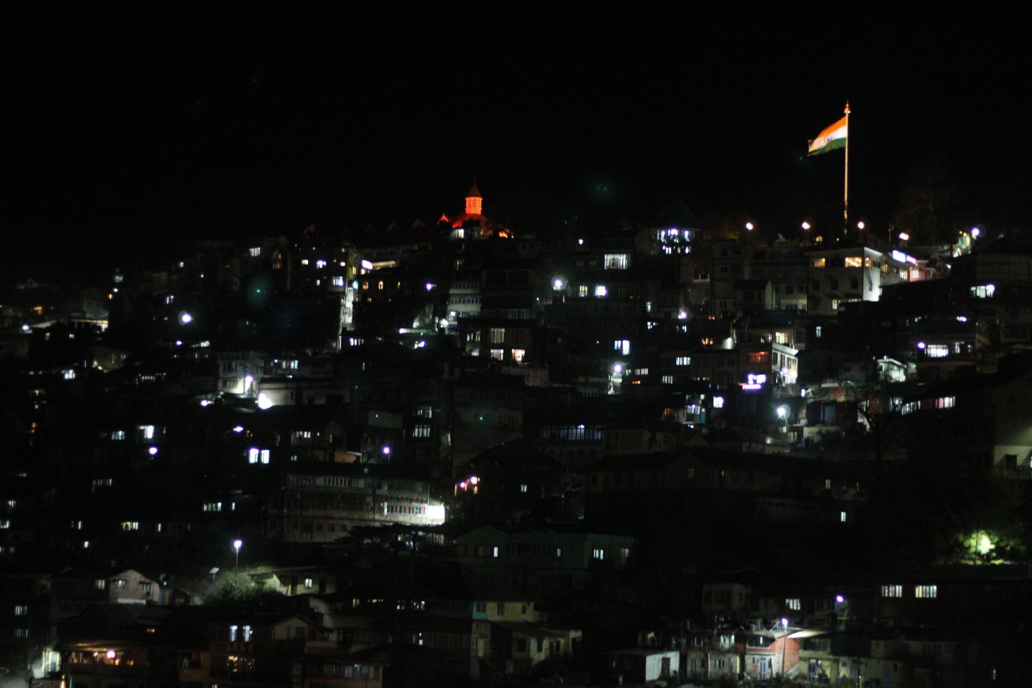
Thank You

